Slide 1
19 Apr 2019
Express + Middleware
By : Khan M. Tabish & Rajesh

Slide 2
Agenda
Understanding of Project Structure
Creating Express Server
Basic Routing
Your own Tomcat
Routing in depth
Middleware
Error Handling
Starting with express-generator
Exercises on ExpressJs

Slide 3
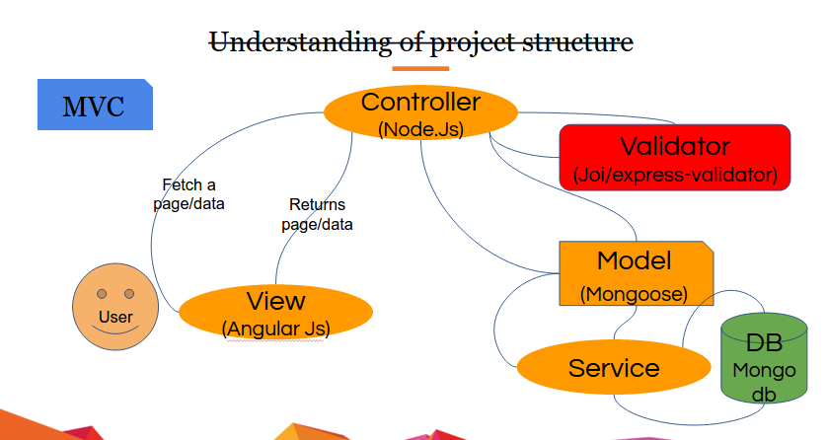
Understanding of Project Structure

Slide 4
Creating Express Server
Create Project & Install Express-Js
$ mkdir express-app && cd express-app
$ mkdir -p router views
$ touch router/index.js views/index.html views/about.html server.js
$ npm init
$ npm i express --save
Add dependencies in package.json
"dependencies": { "express": "~4.15.2", "ejs":"~2.5.6" }
$ npm install

Slide 5
Creating Express Server
Creating Express Server(Hello.World!)
"use strict"; //Step1:start app at port 3000 //server.js const Express = require('express'); const PORT = 3000; const app = Express(); app.listen(PORT);
//Step2: Add callback to listen function //server.js app.listen(PORT, () => { console.info("Server is running @:http://localhost:%d", PORT); });

Slide 6
Basic Routing(Exposure to REST)
//server.js //... const app = Express(); //... app.get('/', (req, res) => { res.send('Hello World!'); }); //... app.listen(PORT, () => {
console.info("Server is running @:http://localhost:%d", PORT);
});
//...

Slide 7
Basic Routing(Exposure to REST)
Routing module
//router/index.js module.exports = (app) => { app.get('/', (req, res) => { res.send('Hello World!'); }); app.get('/emp.json', (req, res) => { res.send(JSON.stringify([ {name: ‘EMP-1’, id: 1}, {name: 'EMP-2’, id: 2}, {name: ‘EMP-1’, id: 3} ])); }); }
//server.js //require router module const router = require('./router'); //add routes router(app);

Slide 8
Basic Routing(Exposure to REST)
Routing module- Send file
//router/index.js
const fs = require('fs');
const path = require('path'); module.exports = (app) => { //... app.get('/', (req, res) => { // maybe test for existence here using fs.stat res.writeHead(200, {"Content-Type": "text/html"}); fs .createReadStream(path.resolve('views', 'index.html')) .pipe(res); }); }

Slide 9
Your own Tomcat(Public Server)
//server.js const router = require('./router'); //.. //add static server app.use('/static', Express.static('views')); //.. //add routes

Slide 10
Routing in Depth
//router/users.js //"use strict"; module.exports = (app) => { app.get('/user', (req, res) => { res.send(JSON.stringify([ {name: ‘User-1’, id: 1}, {name: ‘User-2’, id: 2}, {name: ‘User-3’, id: 3} ])); }); app.post('/user', (req, res) => { res.send('Got a POST request'); }); app.put('/user', (req, res) => { res.send('Got a PUT request at /user'); }); app.delete('/user', (req, res) => { res.send('Got a DELETE request at /user'); }); }
//server.js const router = require('./router'); //...require new routes const userRouter = require('./router/users'); router(app); //...ad user routes userRouter(app); //... app.listen(PORT, () => { });

Slide 11
Routing in Depth
Chainable Routing- app.route()
//router/books.js app.route('/book') .get((req, res) => { res.send('Get a random book'); }) .post((req, res) => { res.send('Add a book'); }) .put((req, res) => { res.send('Update the book'); });

Slide 12
Routing in Depth
Express Router- express.Router()
//router/birds.js "use strict"; const express = require('express'); const router = express.Router(); // middleware that is specific to this router router.use((req, res, next) => { console.log('Time: ', Date.now()); next(); });
// define the home page route router.get('/', (req, res) => { res.send('Birds home page'); }); // define the about route router.get('/about', (req, res) => { res.send('About birds'); }); module.exports = (app) => { app.use('/birds', router); };

Slide 13
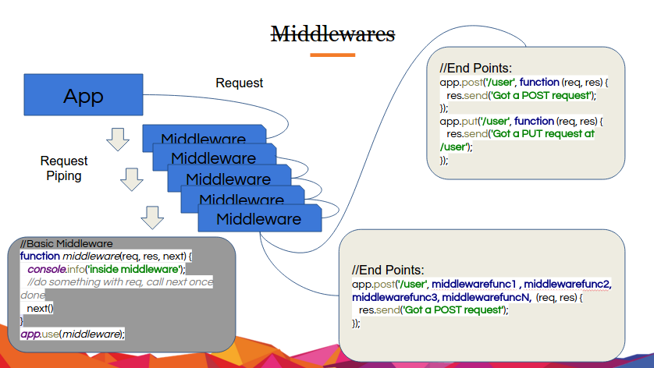
Middleware

Slide 14
Middleware : Overview
Middleware functions are functions that have access to the request object (req), the response object (res), and the next function in the application’s request-response cycle. The next function is a function in the Express router which, when invoked, executes the middleware succeeding the current middleware.
Middleware functions can perform the following tasks:
Execute any code.
Make changes to the request and the response objects.
End the request-response cycle.
Call the next middleware in the stack.

Slide 15
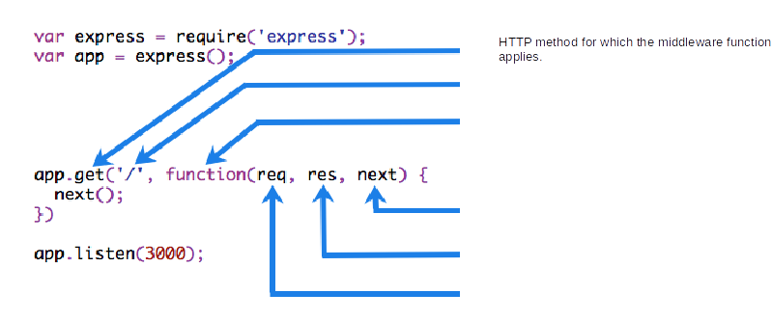
Understanding Middleware
If the current middleware function does not end the request-response cycle, it must call next() to pass control to the next middleware function. Otherwise, the request will be left hanging.
The following figure shows the elements of a middleware function call:
HTTP method for which the middleware function applies.
Path (route) for which the middleware function applies.
The middleware function.
Callback argument to the middleware function, called "next" by convention.
HTTP response argument to the middleware function, called "res" by convention.
HTTP request argument to the middleware function, called "req" by convention.

Slide 16
Middleware function myLogger
Here is a simple example of a middleware function called “myLogger”. This function just prints “LOGGED” when a request to the app passes through it. The middleware function is assigned to a variable named myLogger.
const myLogger = (req, res, next) => {
console.log('LOGGED');
next();
}
Notice the call above to next(). Calling this function invokes the next middleware function in the app. The next() function is not a part of the Node.js or Express API, but is the third argument that is passed to the middleware function. The next() function could be named anything, but by convention it is always named “next”. To avoid confusion, always use this convention.

Slide 17
Middleware function myLogger
Every time the app receives a request, it prints the message “LOGGED” to the terminal.
The order of middleware loading is important: middleware functions that are loaded first are also executed first.
If myLogger is loaded after the route to the root path, the request never reaches it and the app doesn’t print “LOGGED”, because the route handler of the root path terminates the request-response cycle.
The middleware function myLogger simply prints a message, then passes on the request to the next middleware function in the stack by calling the next() function.

Slide 18
Loading Middleware
To load the middleware function, call app.use(), specifying the middleware function. For example, the following code loads the myLoggermiddleware function before the route to the root path (/).
const express = require('express')
const app = express()
const myLogger = (req, res, next) => {
console.log('LOGGED');
next();
}
app.use(myLogger)
app.get('/', (req, res) => {
res.send('Hello World!');
})
app.listen(3000);

Slide 19
Middleware functions request time.
Next, we’ll create a middleware function called “requestTime” and add it as a property called requestTime to the request object.
const express = require('express')
const app = express()
const requestTime = (req, res, next) => {
req.requestTime = Date.now();
next();
}
app.use(requestTime);
app.get('/', (req, res) => {
var responseText = 'Hello World!<br>'
responseText += '<small>Requested at: ' + req.requestTime + '</small>'
res.send(responseText);
});
app.listen(3000);

Slide 20
Middleware
//server.js //logging middleware function middleware(req, res, next) { console.info('inside middleware'); //do something with req, call next once done next(); } //how to use it app.use(middleware); //add static server app.use('/static', Express.static('views'));
Exercise- Create a request logging middleware

Slide 21
Error-handling Middleware
Error-handling middleware always takes four arguments. You must provide four arguments to identify it as an error-handling middleware function. Even if you don’t need to use the next object, you must specify it to maintain the signature. Otherwise, the next object will be interpreted as regular middleware and will fail to handle errors.
Define error-handling middleware functions in the same way as other middleware functions, except with four arguments instead of three, specifically with the signature (err, req, res, next)):
app.use((err, req, res, next) => {
console.error(err.stack);
res.status(500).send('Something broke!');
});

Slide 22
Default Error Handler
Express comes with a built-in error handler, which takes care of any errors that might be encountered in the app. This default error-handling middleware function is added at the end of the middleware function stack.
If you pass an error to next() and you do not handle it in an error handler, it will be handled by the built-in error handler; the error will be written to the client with the stack trace. The stack trace is not included in the production environment.
If you call next() with an error after you have started writing the response (for example, if you encounter an error while streaming the response to the client) the Express default error handler closes the connection and fails the request.
So when you add a custom error handler, you will want to delegate to the default error handling mechanisms in Express, when the headers have already been sent to the client:
function errorHandler (err, req, res, next) {
if (res.headersSent) {
return next(err);
}
res.status(500);
res.render('error', { error: err });
}
Note that the default error handler can get triggered if you call next() with an error in your code more than once, even if custom error handling middleware is in place

Slide 23
Error Handling
//server.js userRouter(app); //error handling middleware //This should be after last app.use function errorHandler(err, req, res, next) { console.info(err); res.status(500).send(err.message); } app.use(errorHandler); //route/index.js app.get('/error', (req, res, next) => { return next(new Error("Throwing error from /error")); res.send('This wil never reached'); });

Slide 24
Third party Middleware
The following example illustrates installing and loading the cookie-parsing middleware function cookie-parser.
$ npm install cookie-parser
const express = require('express');
const app = express();
const cookieParser = require('cookie-parser');
// load the cookie-parsing middleware
app.use(cookieParser());
Parse Cookie header and populate req.cookies with an object keyed by the cookie names. Optionally you may enable signed cookie support by passing a secret string, which assigns req.secret so it may be used by other middleware.

Slide 25
Third party Middleware
Parse incoming request bodies in a middleware before your handlers, availabe under the req.body property.
This does not handle multipart bodies, due to their complex and typically large nature.
$ npm install body-parser

Slide 26
Starting with express-generator
##Express Generator ###Install
$ npm i express-generator -g
###Create gapp
$ express <app-name>
Notes:
Point to Remember
app.set('views', __dirname + '/public/'); app.engine('html', require('ejs').renderFile); app.set('view engine', 'html'); //And res.render(path.resolve('public', 'about.html'),{user: "Great User",title:"homepage"});

Slide 27
Exercise
1. Create a user application which will have a home page, add user page and about us page
2. On Home, It will list all user in a table. There will be one more column Action in a table which will have a delete option to delete the user.
3. On add New user page, there will be form to create a new user. There will be a middleware that will add the created_on date in user when new user will be created.
4. On About-us page, there will some description of app and app creator.
Notes:
Point to Remember
app.set('views', __dirname + '/public/'); app.engine('html', require('ejs').renderFile); app.set('view engine', 'html'); //And res.render(path.resolve('public', 'about.html'),{user: "Great User",title:"homepage"});

Slide 28
Thank You
Any queries? Open to Q&A

